Slide 1


BASICS OF RC PLANE

Slide 2
Overview
What is RC Plane?
RC Planes’ Parts and their Role
How planes fly?
Concepts and Terminologies of RC Plane
Stability and Control
How to design your own plane?
Building your own design
How to fly?

Slide 3
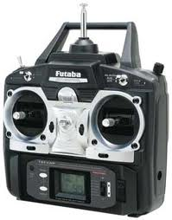
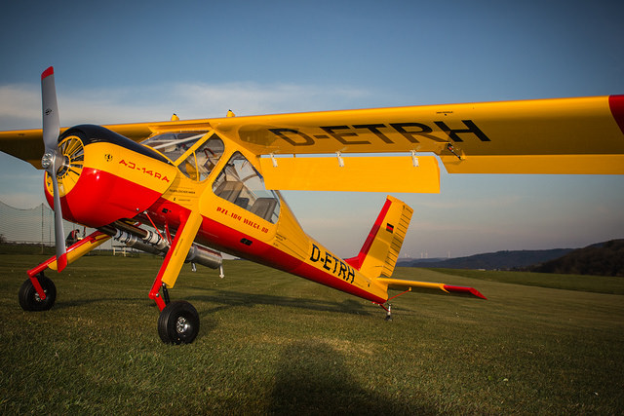
What is RC Plane?
Small radio-controlled model airplanes powered using electric motor or gas engines
Flown using transmitter with joysticks

Slide 4
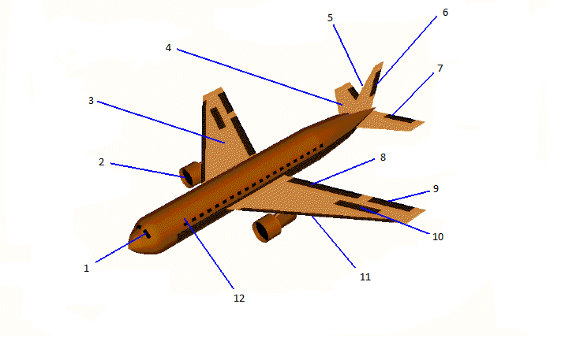
Different Parts of RC Plane
Vertical Stabiliser
Rudder
Horizontal Stabiliser
Elevator
Wing
Jet Engine
Flaps
Ailerons
Spoilers
Cockpit
Slats
Fuselage (Body)

Slide 5
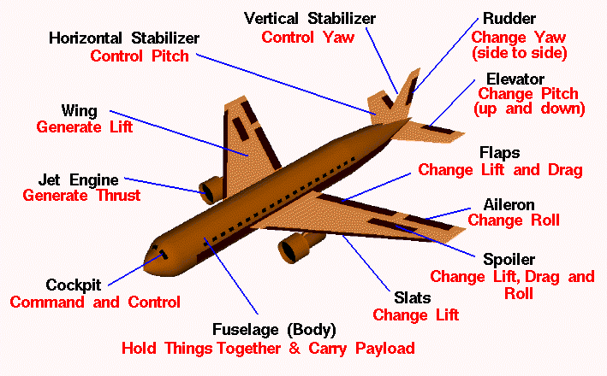
Different Parts of RC Plane

Slide 6
Different Parts of RC Plane
We can categorize different parts of RC plane as following:
Control Surfaces which are ailerons, elevators and rudder.
Stabilizers include vertical and horizontal stabilizer.
Other parts which include fuselage, engine or power source and propeller.

Slide 7
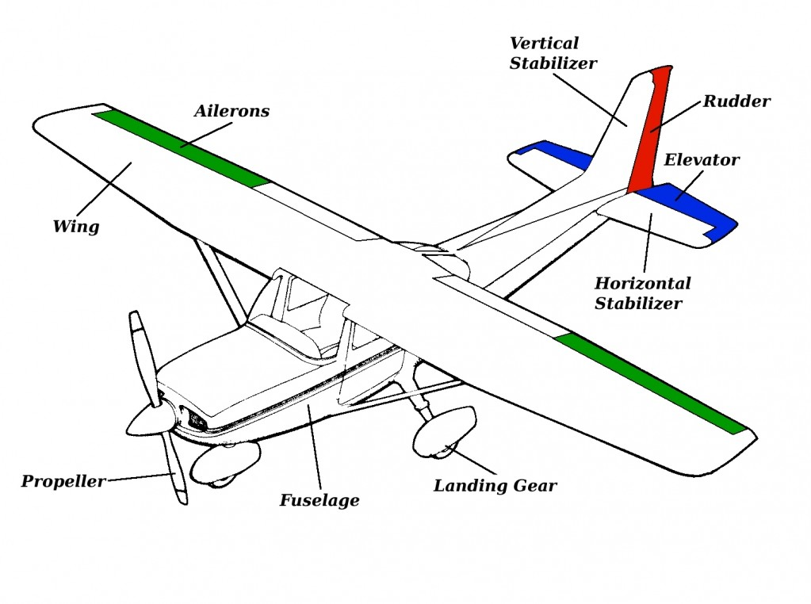
Different Parts of RC Plane

Slide 8
Forces on Plane
The negative forces:-
Drag
Weight
We counter them by:-
Lift for Weight
Thrust for Drag

Slide 9

How the planes fly?
Lift Generation
What is Lift?
Airfoil?
Angle of Attack?
L = ½ ρV²AαC_{L}
C_{L} ~ 0.8-1

Slide 10
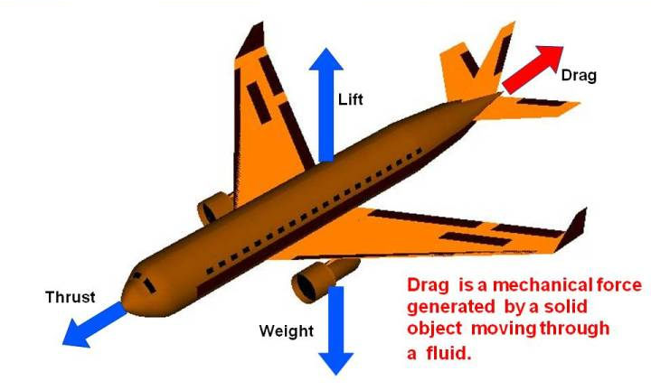
Concepts and Terminologies
Drag

Slide 11
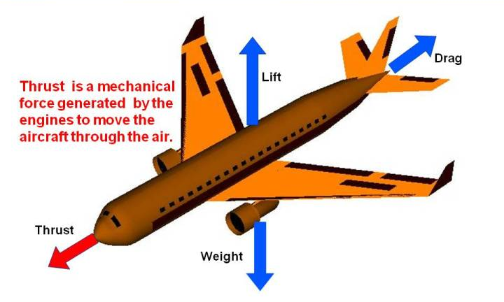
Concepts and Terminologies
Thrust

Slide 12
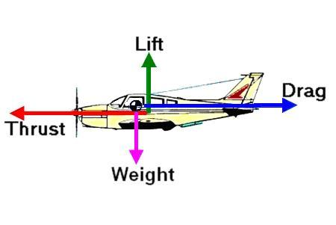
Summing Up

Slide 13
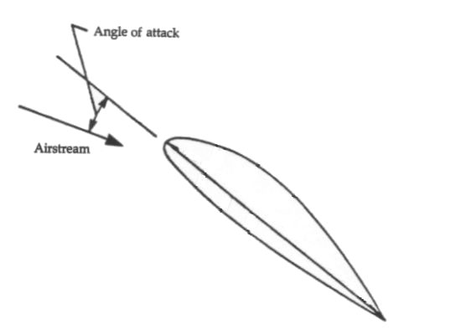
Concepts and Terminologies
Angle of attack

Slide 14
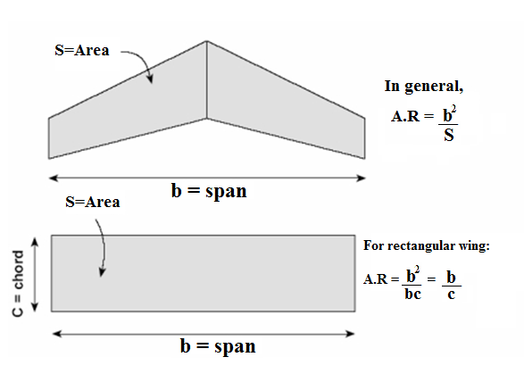
Concepts and Terminologies
Wing Chord (c)
Wing Span (b)
Plane form Area (s)
Aspect Ratio (AR)

Slide 15
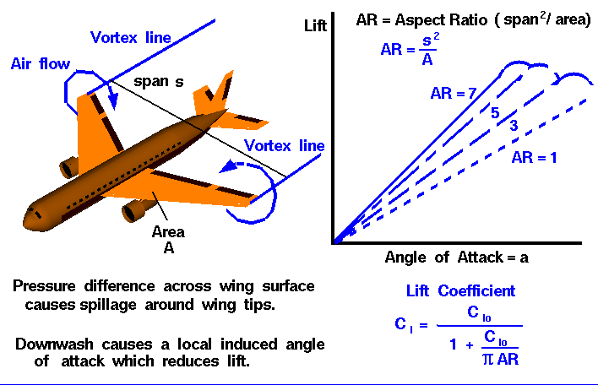
Concepts and Terminologies
Effect of Aspect Ratio on Lift

Slide 16
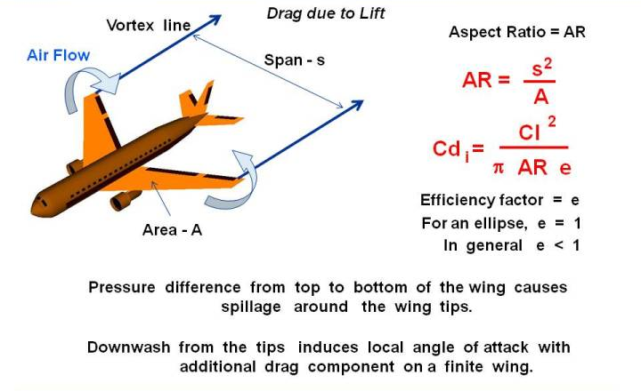
Concepts and Terminologies
Effect of Aspect Ratio on Drag

Slide 17
Stability and Control
A plane can rotate about three axes-
Roll
Pitch
Yaw
To attain control over these three axes, we have-
Ailerons for Roll
Elevator for Pitch
Rudder for Yaw

Slide 18
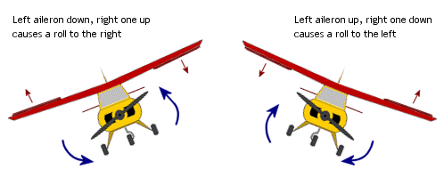
Stability and Control
Roll Motion

Slide 19
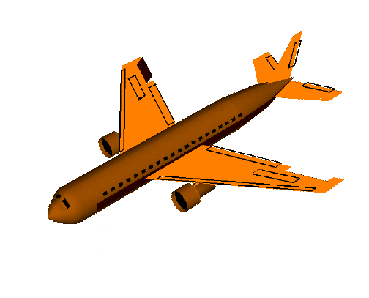
Roll Motion

Slide 20
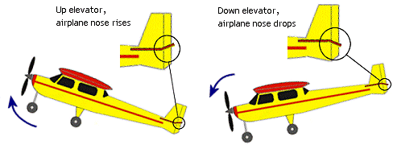
Concepts of RC Plane
Pitch Motion

Slide 21
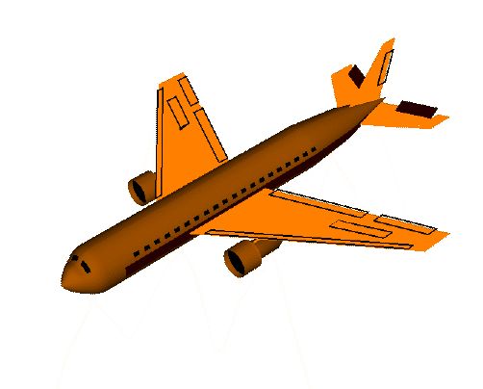
Pitch Motion

Slide 22
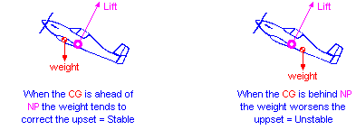
Stability and Control
Horizontal Stabilizer

Slide 23
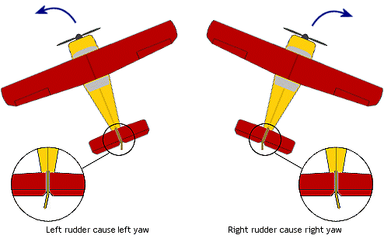
Stability and Control
Yaw Motion

Slide 24
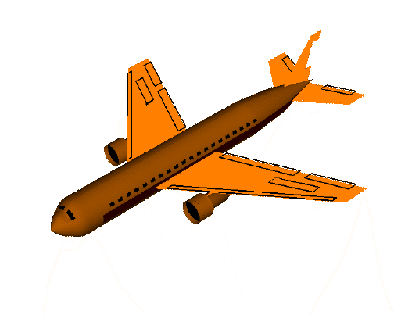
Yaw Motion

Slide 25
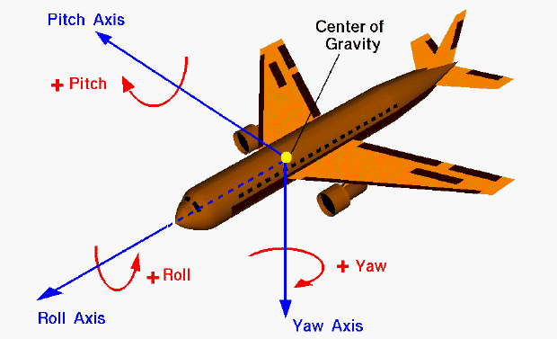
Axes of Rotation

Slide 26
How to make your own?
Step 1
Developing your own design
Step 2
Constructing your own design
Step 3
How to fly?

Slide 27
Step 1
Developing your own Design
Determine wing dimensions
Set lift = target aircraft weight
Use approximate velocity to determine the area
C_{L} ~ 0.8 - 1
ρ = Density of air (1.225)
V = velocity of the aircraft
S = Wing area
Select A.R (4 – 6). Determine chord and wingspan

Slide 28
Step 1
Developing your own Design
Determine wing dimensions
Horizontal Tail Sizing
H.T.A ~ 20% of wing area
H.T.A = Horizontal Tail Area
Horiz. Tail at approx. 2.5 times to the aft of CG
A.R to lie in the range of 4-5

Slide 29
Step 1
Developing your own Design
Determine wing dimensions
Horizontal Tail Sizing
Vertical Tail Sizing
V.T.A = 8 – 10% of Wing area
V.T.A = Vertical Tail Area
Aspect Ratio in the range of 2.5-3

Slide 30
Step 1
Developing your own Design
Determine Wing dimensions
Horizontal Tail Sizing
Vertical Tail Sizing
Determining fuselage length
Fuselage length ~ 0.8 times wingspan
Fuselage length from CG to Horizontal Stabilizers ~2.5 times wing chord

Slide 31
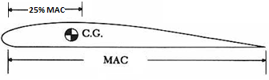
Step 1
Developing your own Design
Determine Wing dimensions
Horizontal Tail Sizing
Vertical Tail Sizing
Determining fuselage length
CG location
CG should be ahead of the wing’s quarter chord

Slide 32
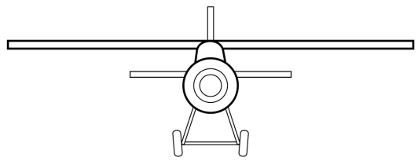
Step 1
Developing your own Design
Determine Wing dimensions
Horizontal Tail Sizing
Vertical Tail Sizing
Determining fuselage length
CG location
Wing Positioning
High wing configuration
Easy to construct and stable

Slide 33
Step 1
Developing your own Design
Determine Wing dimensions
Horizontal Tail Sizing
Vertical Tail Sizing
Determining fuselage length
CG location
Wing Positioning
Electronic Component Selection

Slide 34
Electronic Component Selection
Powerplant
BLDC (Brushless DC Motor)
Propeller
ESC (Electronic Speed Controller )
Servo Motors
Li-Po Battery
Transmitter & Receiver
We will go over them in the upcoming sessions

Slide 35
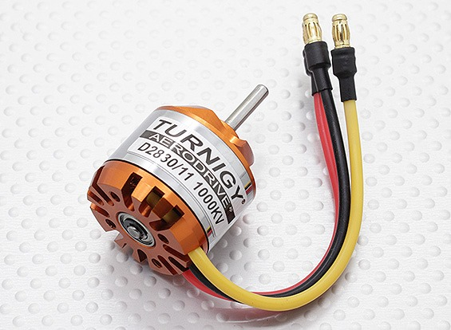
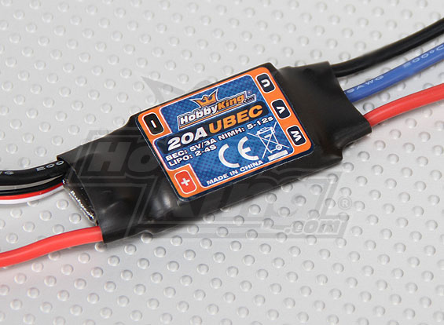
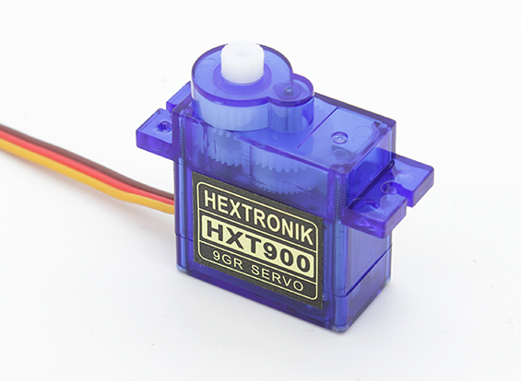
Brushless DC Motor Electronic Speed Controller
Servo Motor

Slide 36
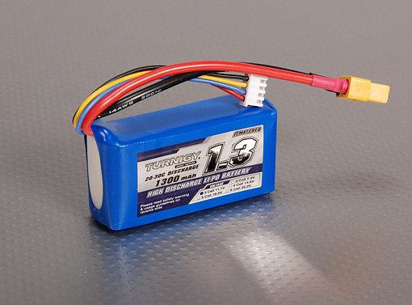
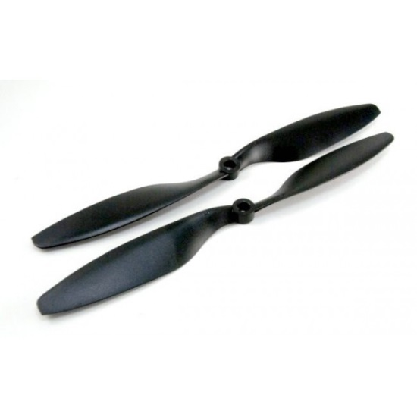
Li – Po Battery
Propeller

Slide 37
Safety Regarding Li-Po
Never Discharge LiPo Completely
Always Store in Cool Location away from sunlight
Away from flammable materials
Always wrap in foam for crash resistance
Use appropriate connectors (Ultra Deans)
Never discharge over C limit(30C burst-30sec)
Next Lipo-Explosion

Slide 38
Step 2
Constructing your own Design
Materials required for the structure
Styrofoam
Corrugated Plastic (Coroplast)
Balsa Wood
Other materials required for constructing
Epoxy Glue (Bond – Tite)
Masking Tape
Double – Sided Tape (DST)
Cutters
We will further discuss about the materials to choose in the upcoming sessions.

Slide 39
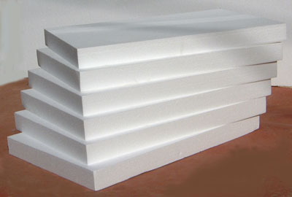
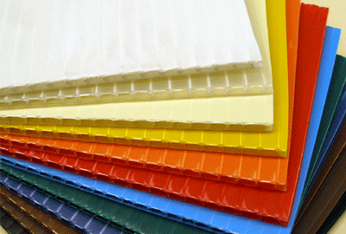
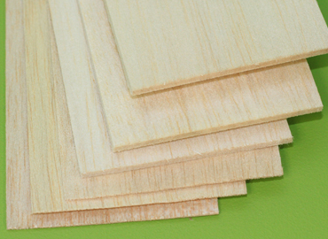
Styrofoam Coroplast
Balsa wood

Slide 40
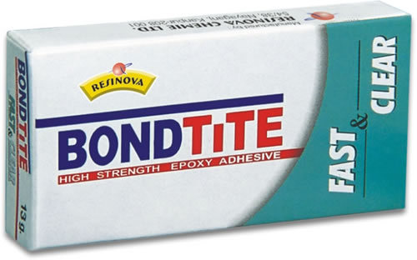
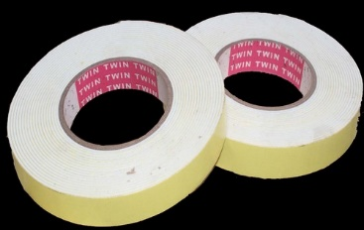
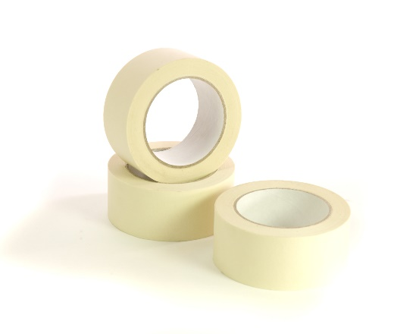
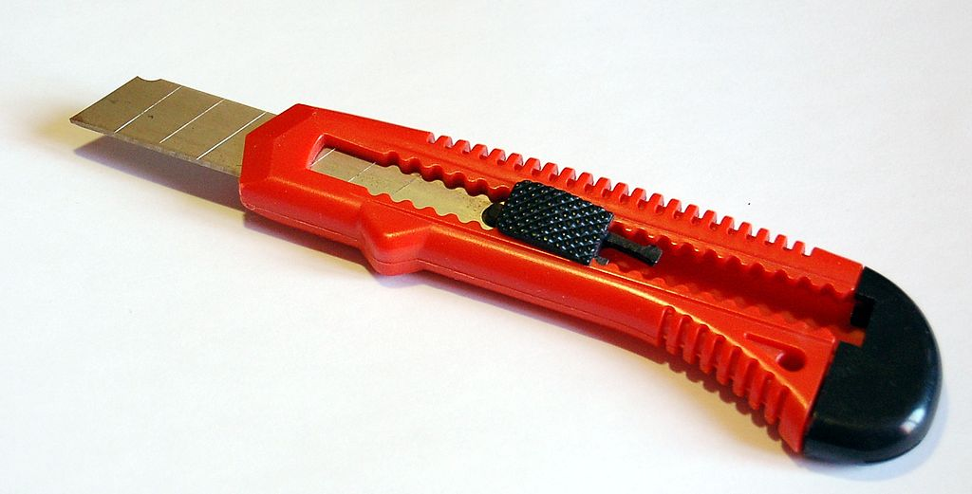
Bond – Tite (Epoxy Glue) Double – Sided Tape (DST)
Masking Tape Cutter

Slide 41
Step 2
Constructing your own Design
Points to note
Symmetric construction
Make sure the plane is symmetrical about roll axis
CG should ideally lie on the roll axis
Keep the CG as low as possible
Keep the empennage (horizontal wing and vertical wing together) light

Slide 42
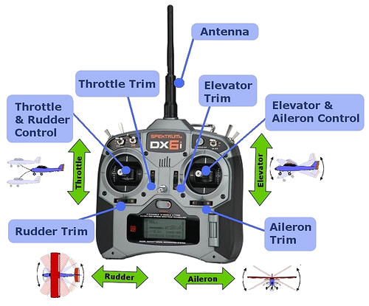
How to Fly?
Step 3
Get comfortable with the controls.

Slide 43
How to Fly?
Step 3
Proper Practice!
One Stop Solution for the above is SIMULATOR SESSION.
Be ready for Crash :P

Slide 44
What Next?
Decide your team (max. 4 and min. 2)
Register your team (Also a Good name :P)
Registration link on
STAB website
FB Group
Google Group
Allotment of Mentors
Then It’s all about your enthu and efforts. :D
Where is your effort required?
Attending workshops
Simulator practice Sessions
Flying practice Sessions

Slide 45
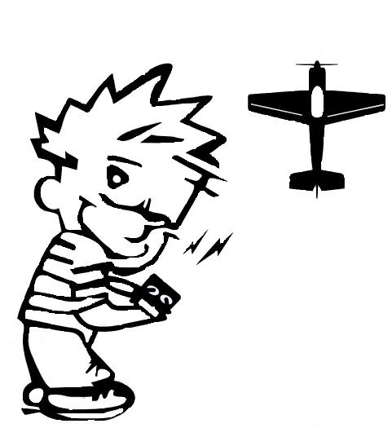

THANK YOU!!!

